Slide 1
FINAL PROJECT REVIEW
WQII APP (WATER QUALITY INDEX INDIA)
TEAM MEMBERS:
PRATYAKSH SHRIVASTAVA 18BCE10195
SUHANI AGRAWAL 18BCE10272
PROJECT GUIDE:
DR. SWAGAT KUMAR SAMANTARAY

Slide 2
INTRODUCTION
This is an application which will determine the usability of water for the particular purpose from the available locations where the Online Continuous Effluent Monitoring Stations is present on the river Ganga. The hardware is already present and we have all the required information for commenting on water quality. We will tell that the water is usable or not, if not then we will see how can we make it usable.

Slide 3
States Drainage area(km)
Uttarakhand and Uttar Pradesh 294,364
Madhya Pradesh and Chhattisgarh 198,962
Bihar and Jharkhand 143,961
Rajasthan 112,490
West Bengal 71,485
Haryana 34,341
Himachal Pradesh 4,317
Delhi 1,484
Total 861,404

Slide 4
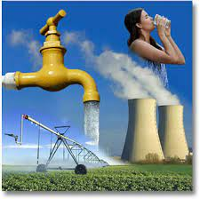
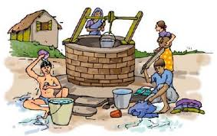
We will see the available parameters like Temperature, Dissolved Oxygen, pH, Conductivity, Biochemical Oxygen Demand, Nitrate, Faecal, Coliform, Total Coliform, Faecal Streptococci of water and can see if it is usable or not. Using the various parameters that can be used to check the purity of water using available information and dataset that we have for the most accurate results.

Slide 5
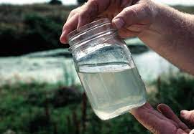
EXISTING WORK
We have the data available with us saying how the water of different regions differs and how can we use them for different - different purposes.
We will take the process to another level and also check many other parameters of water and we have successfully made the app as well supporting two languages and 2 themes with graphical data representation as well.

Slide 6
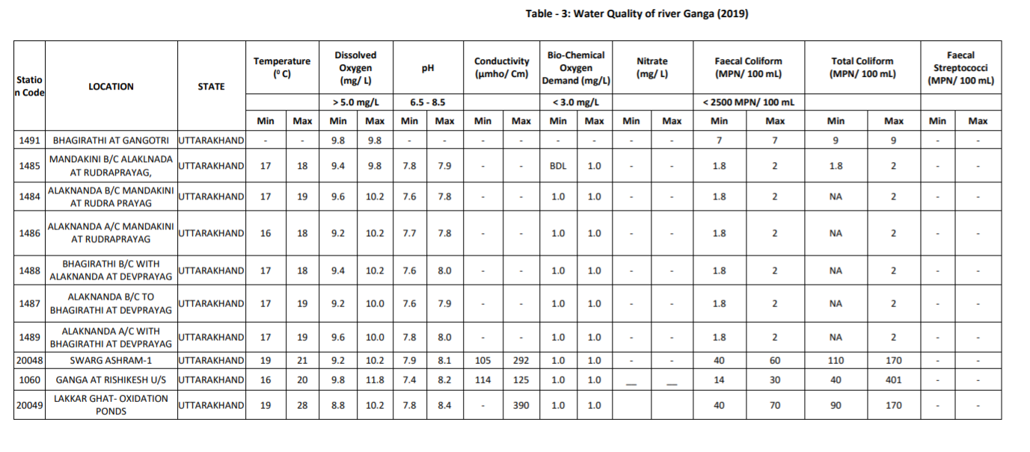
OFFICIAL DATA NAMAMI GANGE

Slide 7

LIMITATIONS
If we want to rely on actual/real-time information and not on the old dataset we need hardware for water bodies that sends live data to a server to see whether the water is usable or not in real-time.

Slide 8
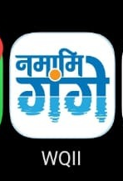
PROPOSED WORK
We have the functional app with all the work that we wanted to provide for most of the part we have also added graphical data for visual representation of data as well. Improvement can be made at any time that’s what we believe and would just need optimization and increasing the efficiency(130 Mb release) that would happen along with time to make it good to go live on the play store if we would like to do that or share the application to the users.

Slide 9
METHODOLOGY
In this application we have taken the 2 datasets (one having the locations and its parameter and the second has all the parameters to verify WQI based on the available parameters) and saved them in the application then we have given the option for the predefined location or manual entry where we compare the 2 to give the WQI accordingly with an option visual representation of data as well. We will see the purity, and turbidity of water and can see if it is usable or not.

Slide 10
NOVELTY
We can see whether the water is usable or not, and if it's usable then we will check and give the possible use case as well unusable scenarios.
We can also see where we can use the water according to its quality like if it's suitable for drinking, agriculture purposes, etc. This information would help the people living around the bank of river Ganga to be safe and yield high output.

Slide 11
REAL TIME USAGE
We can see whether the water we are using is pure or not if not how can we make it pure or how can we use it for other purposes.

Slide 12
REQUIREMENTS
Hardware
A device that checks and uploads WQI(already present).
Software
An Android Phone with Android 6.0 or above.
The basic dataset & Information and calculation.
150 Mb of free space.

Slide 13
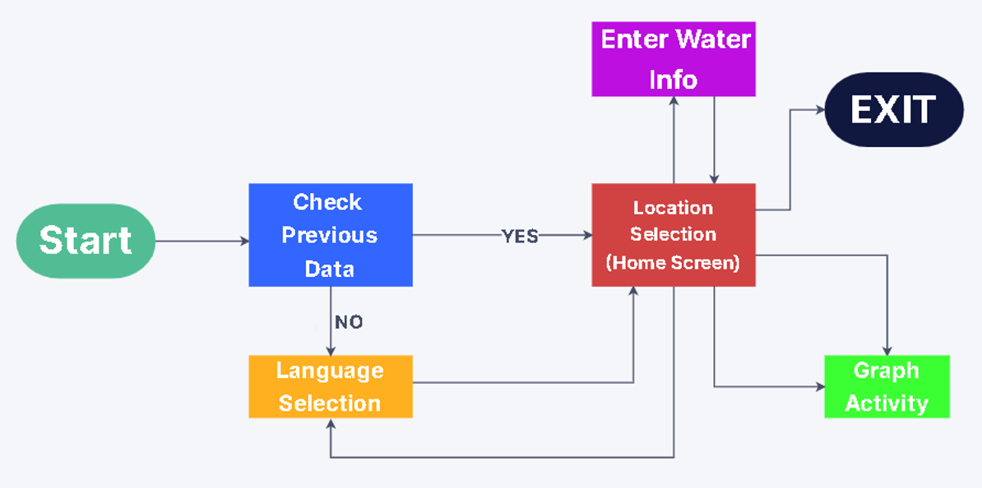
SYSTEM ARCHITECTURE

Slide 14
LITERATURE REVIEW
The Links to the dataset as well as official NamamiGanga live data along with the android developer link which helped us built this app successfully.
http://125.19.52.218/realtime/
https://nmcg.nic.in/NamamiGanga.aspx
https://developer.android.com/studio

Slide 15
MODULES & DESCRIPTION
Enterwaterinfo (Screen where we enter water details manually)
InputFilterMinMax ( Filter for minimum and maximum value )
Languageselection ( Screen where we select the language )
Locationselection ( Screen where we select location & get data )
GraphActivity (Screen where we show the data graphically )
Res ( Contains all the resources like images, strings, values etc. )

Slide 16
IMPLEMENTATION
First, our main goal was to find the correct database to use for the following WQI comparison and the actual data of water bodies.
Then we created a blank application and started with the home screen which is language selection and added code to check if the application has any previous data or not if yes then skip this screen else wait for user input. We also added support for light and dark modes in the app.
Then we had to add the drop-down menu for the 95 available locations with search functionality and make it look like a home screen i.e. make it clean and user friendly.

Slide 17
4. After this we linked this secondary home screen to 3 options which are for going back to language screen to change the language of the app, the manual entry screen where we have data to be entered by the user manually for WQI results and lastly is the Graph screen which shows the change in parameter value along the 95 predefined location.
5. After the flow of control was set we added the dual language functionality.
6. We then added the code to compare the WQI database which defines if the water is usable or not and for which purpose to compare to the data entered by the user in the manual as well as 95 predefined location and to return the result for it.
7. Lastly we did all the Exception handling, Testing and debugging along with Integrated Unit Testing as well which then made our application fully stable to use.

Slide 18
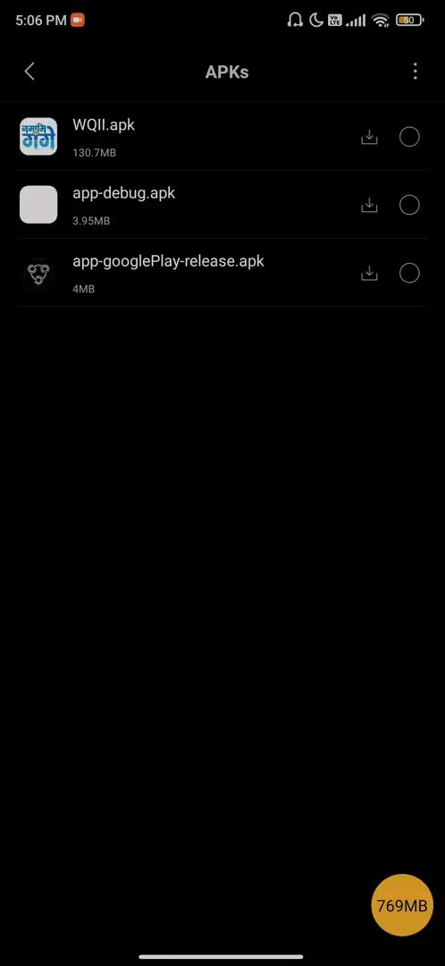
VIDEO LINK

Slide 19
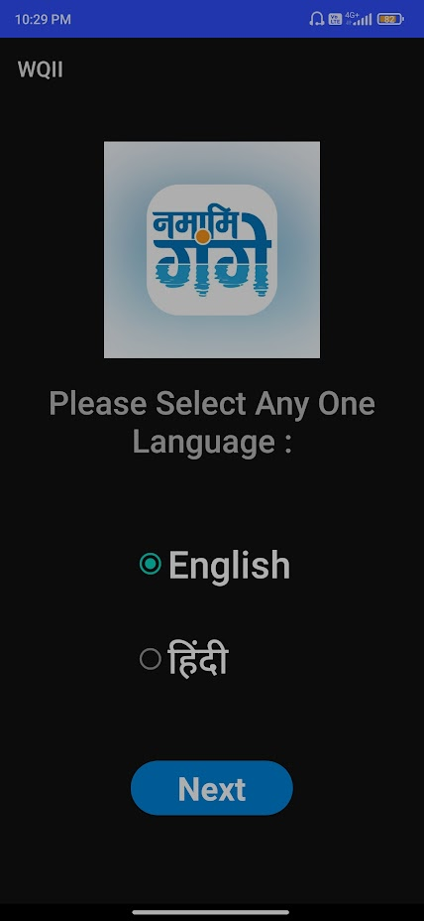
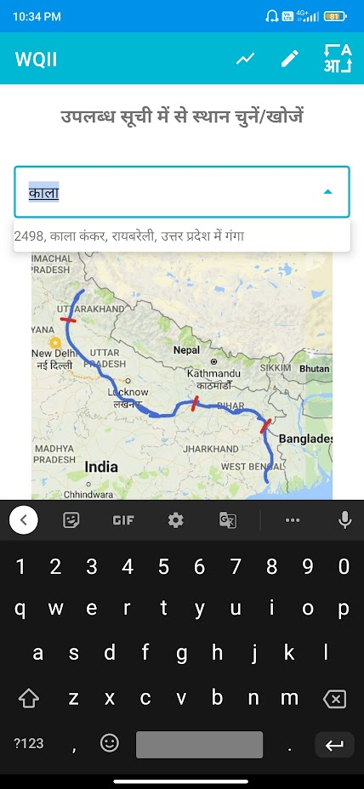
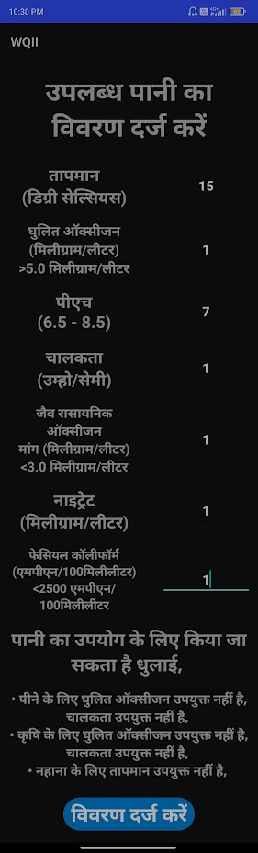
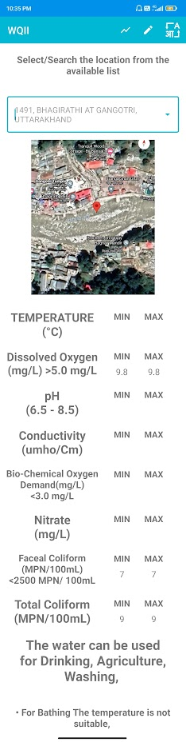
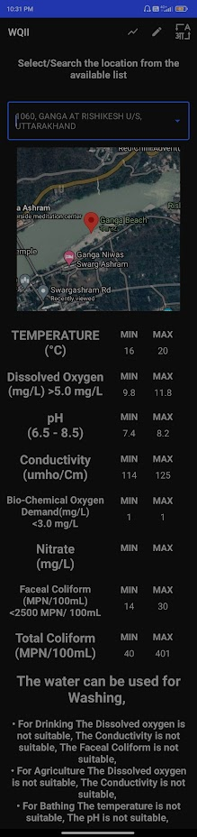
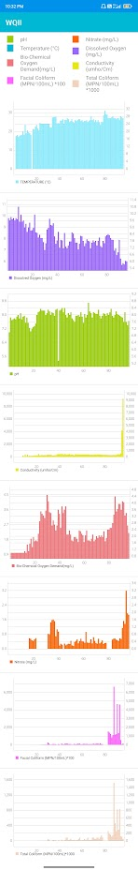

Slide 20
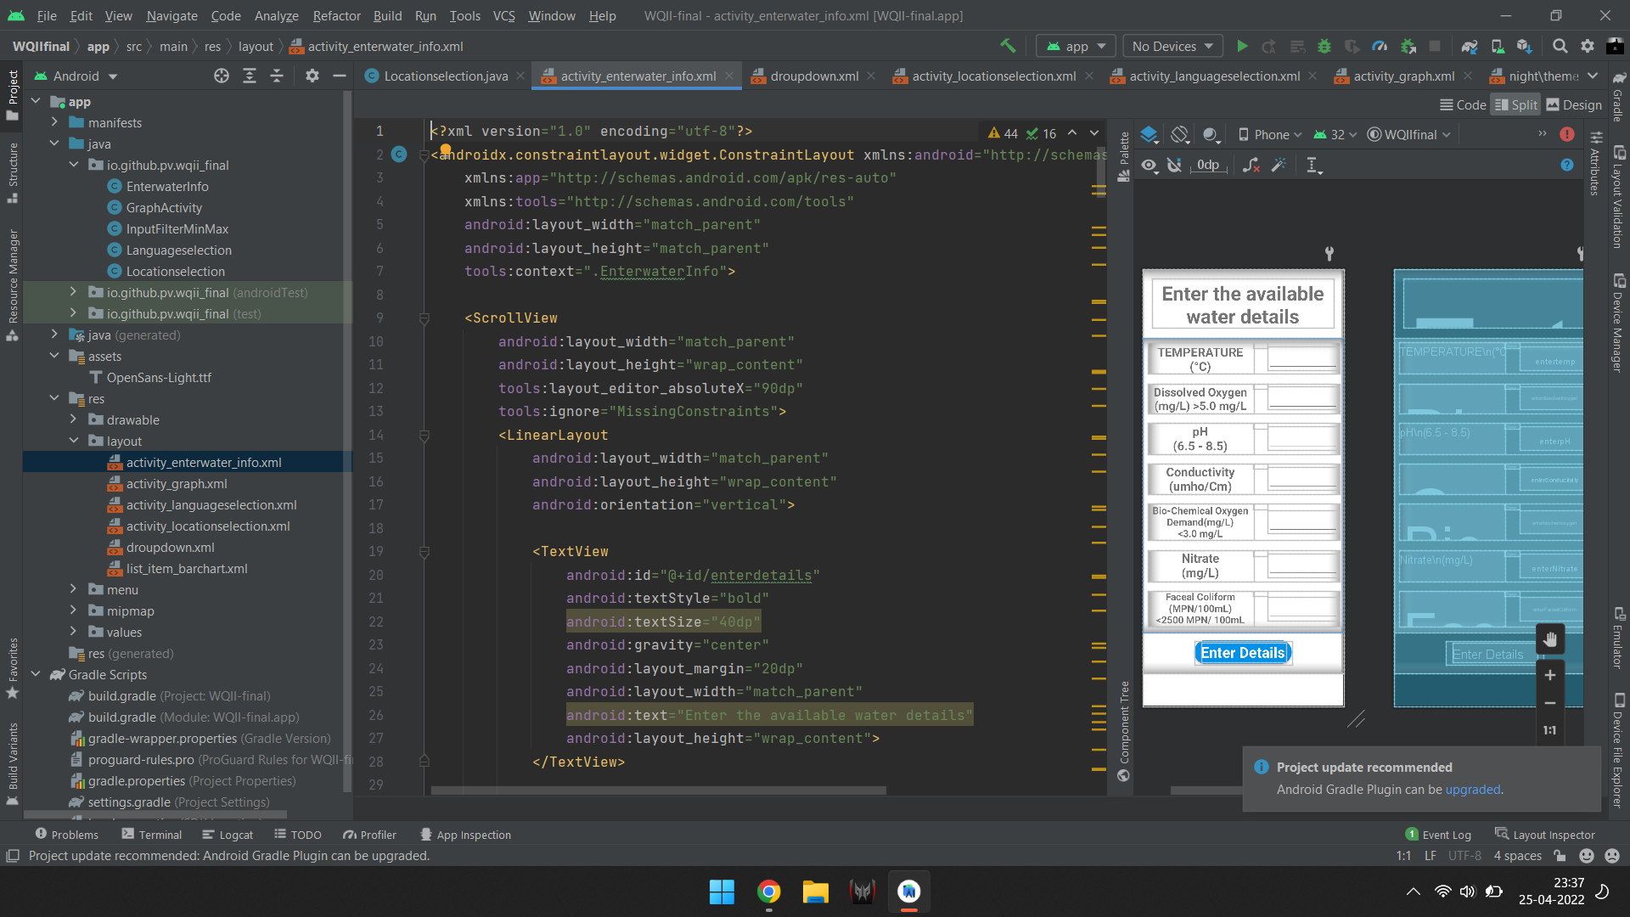
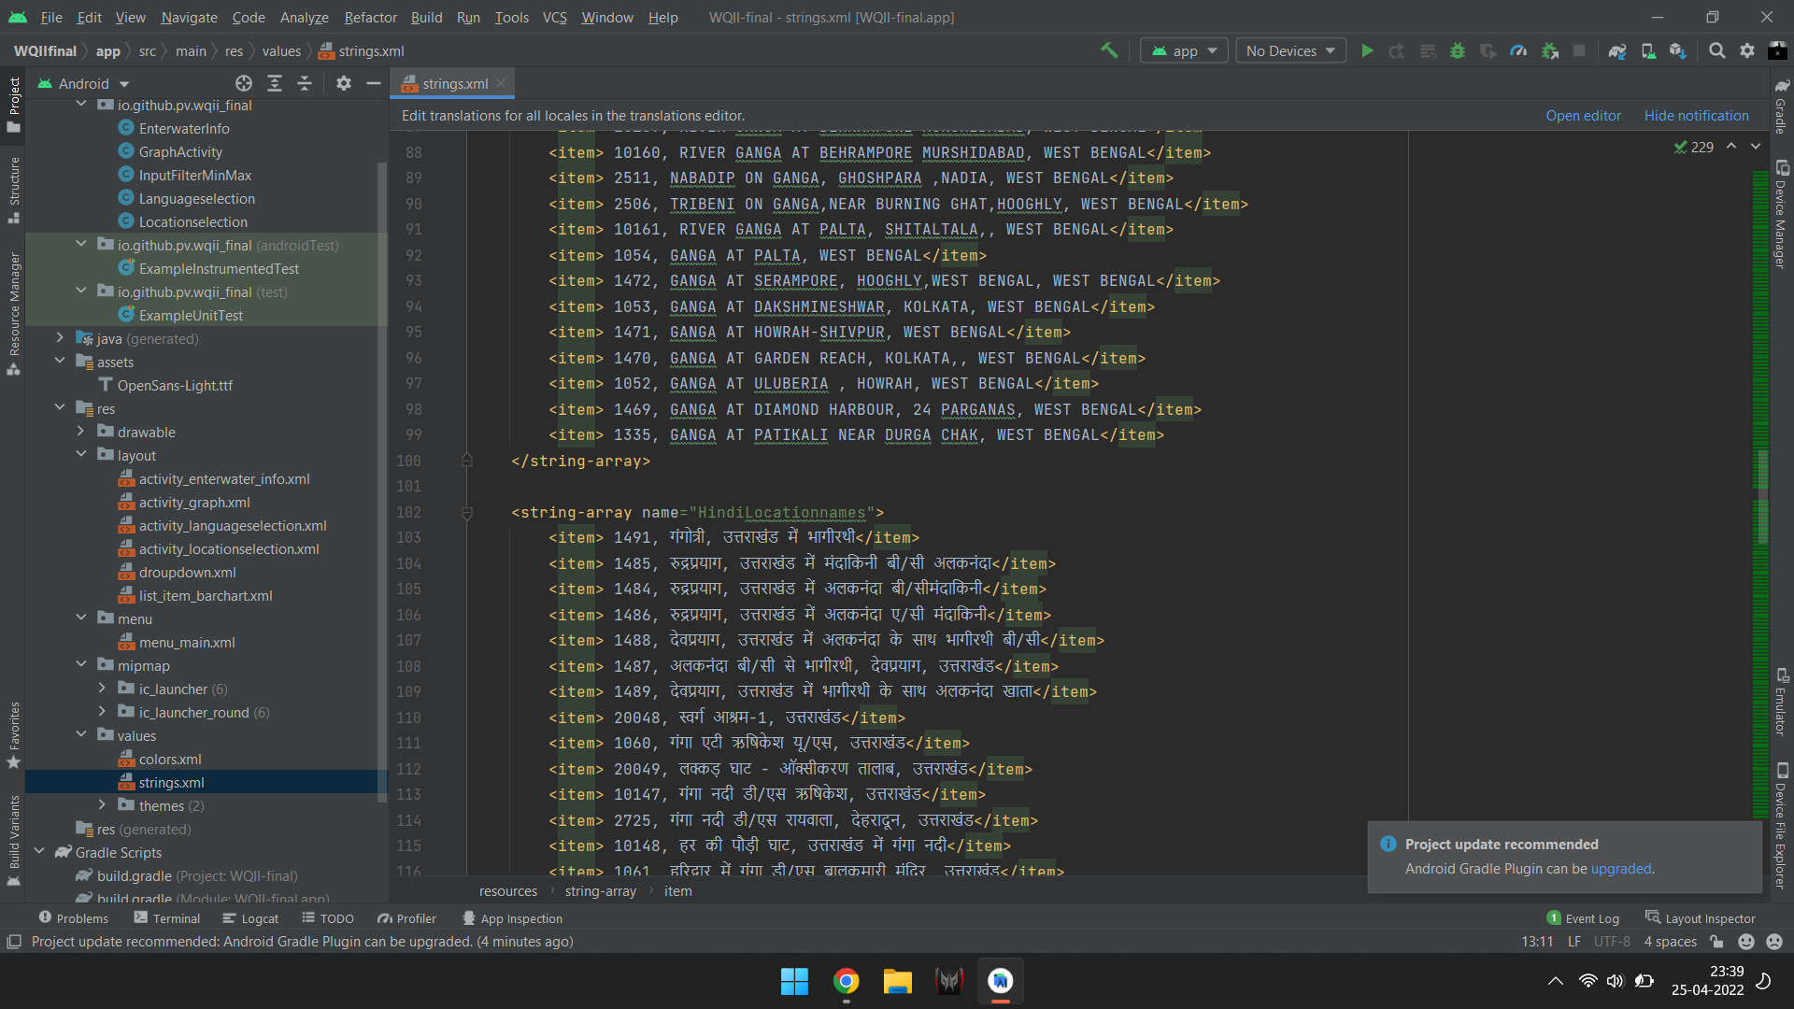
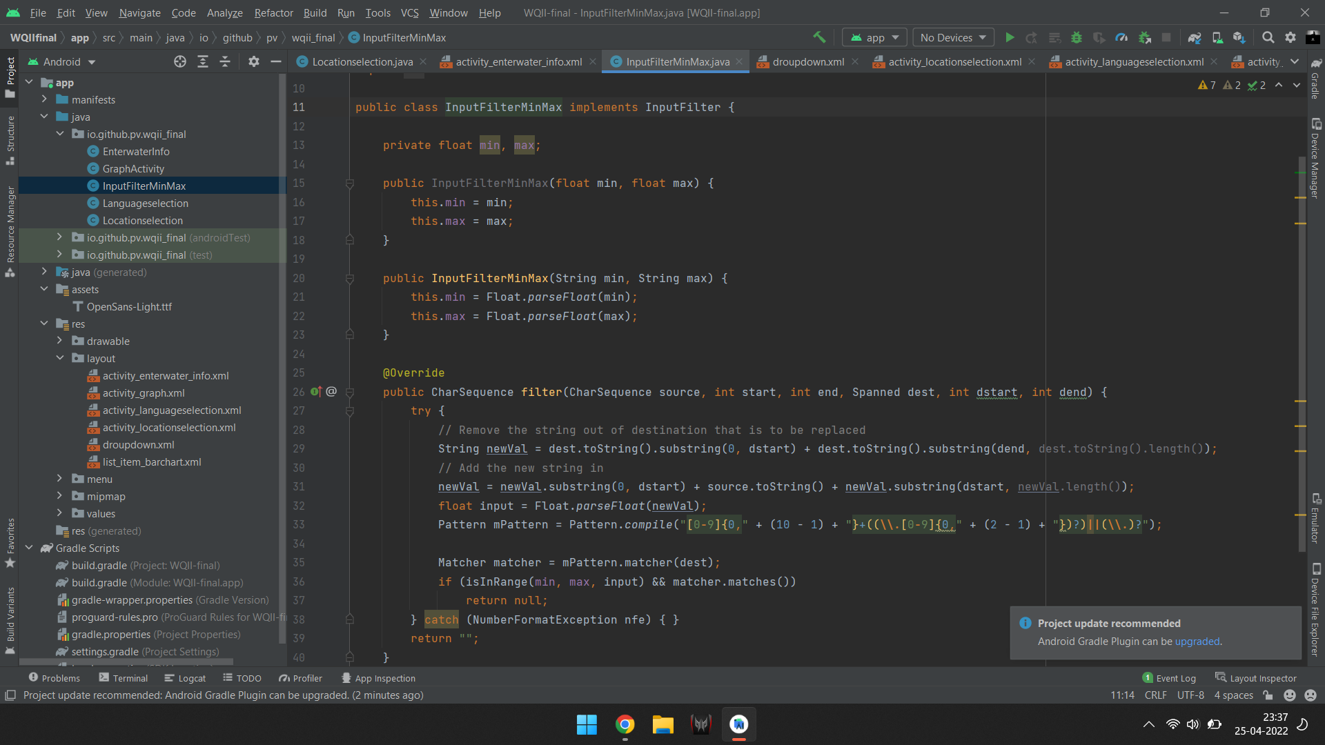
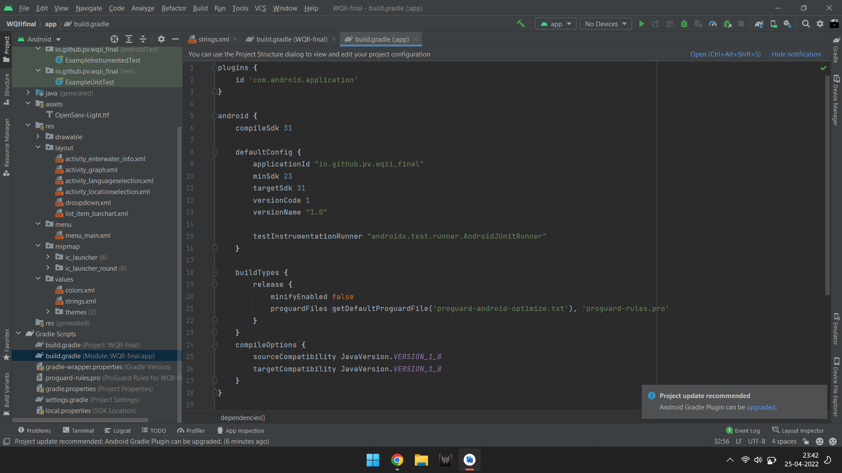

Slide 21
TESTING
We have done exception handling(like the min max function which limits the user from entering wrong values in the manual mode) in the application itself along with that for the android application we have something called Unit & UI Testing. We have done them using the Integrated Unit testing via the inbuilt espresso test that the android studio provides which helps us to know that the application is stable to use.

Slide 22
RESULT
We have successfully created an app that is suitable for English as well as Hindi user along with that we have 95 predefined locations where Ganga flows and has search functionality and have also included the manual option for entering the water quality for any water body, and lastly, we have added a graphical view for more interactiveness of the user.
https://drive.google.com/file/d/18z4n39bch_BJig7d3sqxuBfY80KISo8I/view?usp=sharing

Slide 23
CONCLUSION
We can see whether the water we are using is usable or not if not how can we make it usable or how can we use it for other purposes by the use of our data of the water without having to do this procedure manually.

Slide 24
Thank You

